Slide 1
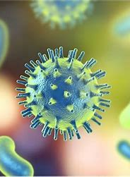
Antibiotics Antiseptics Disinfectants and Antivirals
GTHBY Human Biology

Slide 2
Topic Overview
..\GTHBY 2023 CO.docx

Slide 3
Learning Intentions
Medical intervention to reduce the rate and severity of infection
Antiseptics
Antibiotics
Antivirals

Slide 4
Success criteria
Write a definition for antibiotic, antiseptic, disinfectant and antiviral.
Give an example of an application for each.
Give an example of a compound or medication for each.

Slide 5
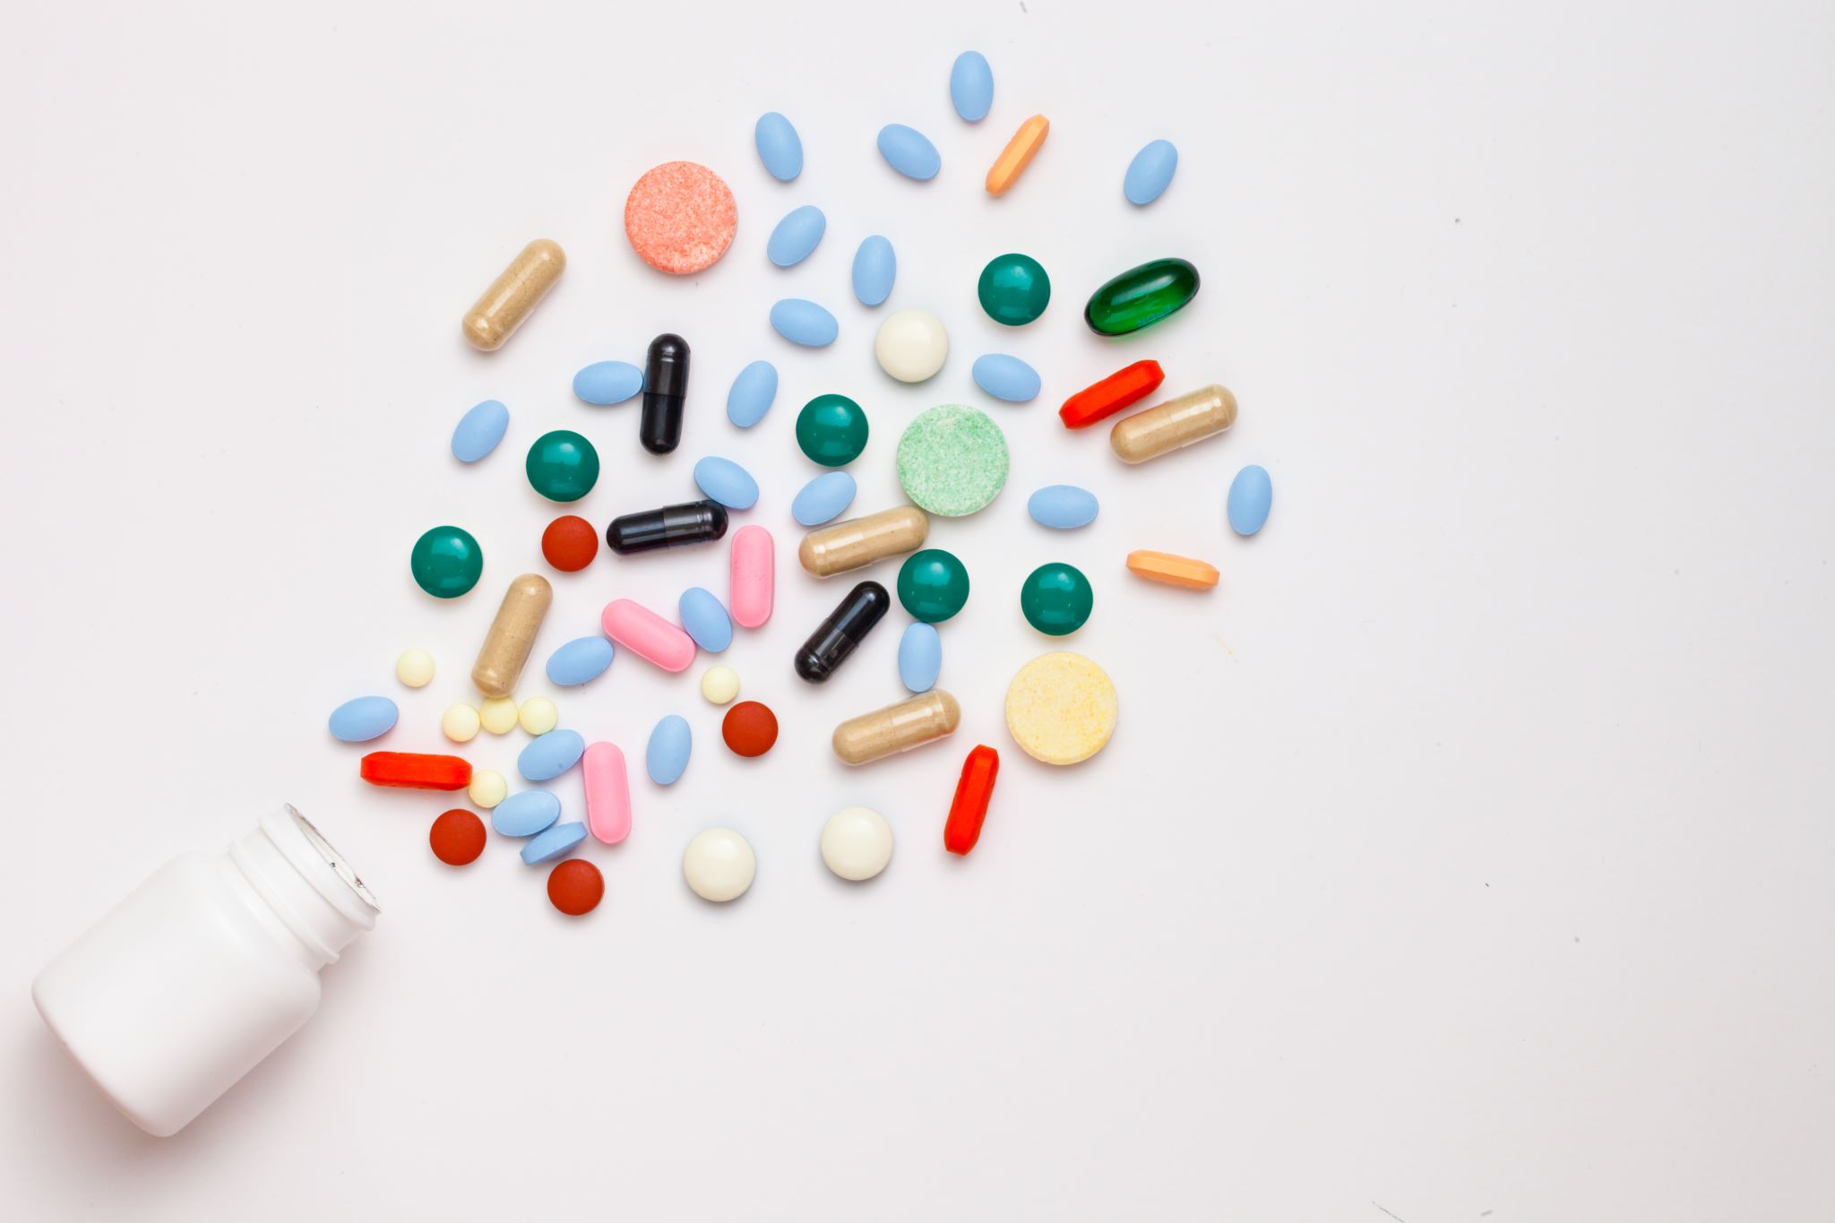
True or false?
You should always finish a course of antibiotics, even if you are feeling better.
There are different medicines for different types of infections.
It is okay to take someone else’s prescription if you have the same illness.
Antibiotics stop you from developing natural immunity.
Antibiotics work for viral infections, like colds and flu.
It is okay to clean surfaces with hand sanitiser.
It is okay to clean your hands with surface cleaner.
You can treat a Covid-19 infection with Clorox and UV.
We need to keep developing new antibiotics because bacteria develop resistance to them (they become less effective).
Superbugs are impossible to kill once they get into your body.

Slide 6
What is an antibiotic?
Antibiotics are medicines that fight infections caused by bacteria in humans and animals by either killing the bacteria or making it difficult for the bacteria to grow and multiply.

Slide 7


Slide 8
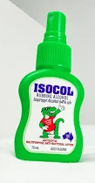
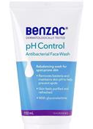
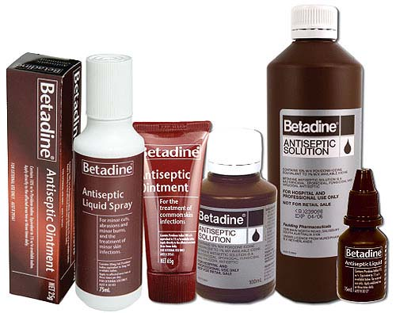
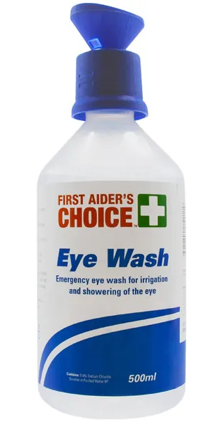
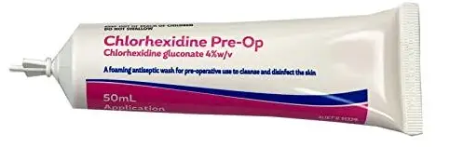
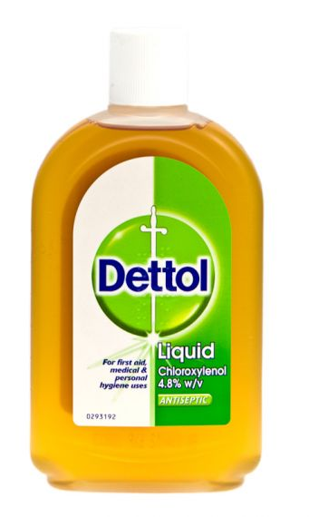

What is an antiseptic?
Antiseptics, or skin disinfectants, are chemicals for cleaning the skin and wounds. They can kill or prevent the growth of microorganisms but do not harm living tissues.
eg chlorhexidine, povidone-iodine, chloroxylenol, isopropyl alcohol, hexachlorophene, benzalkonium chloride, and hydrogen peroxide

Slide 9
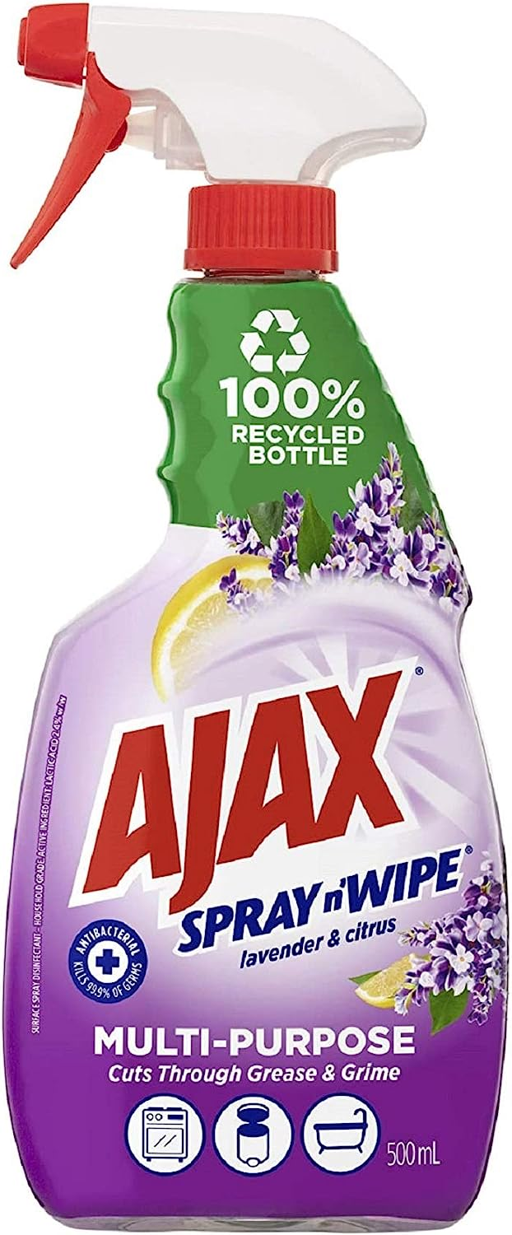
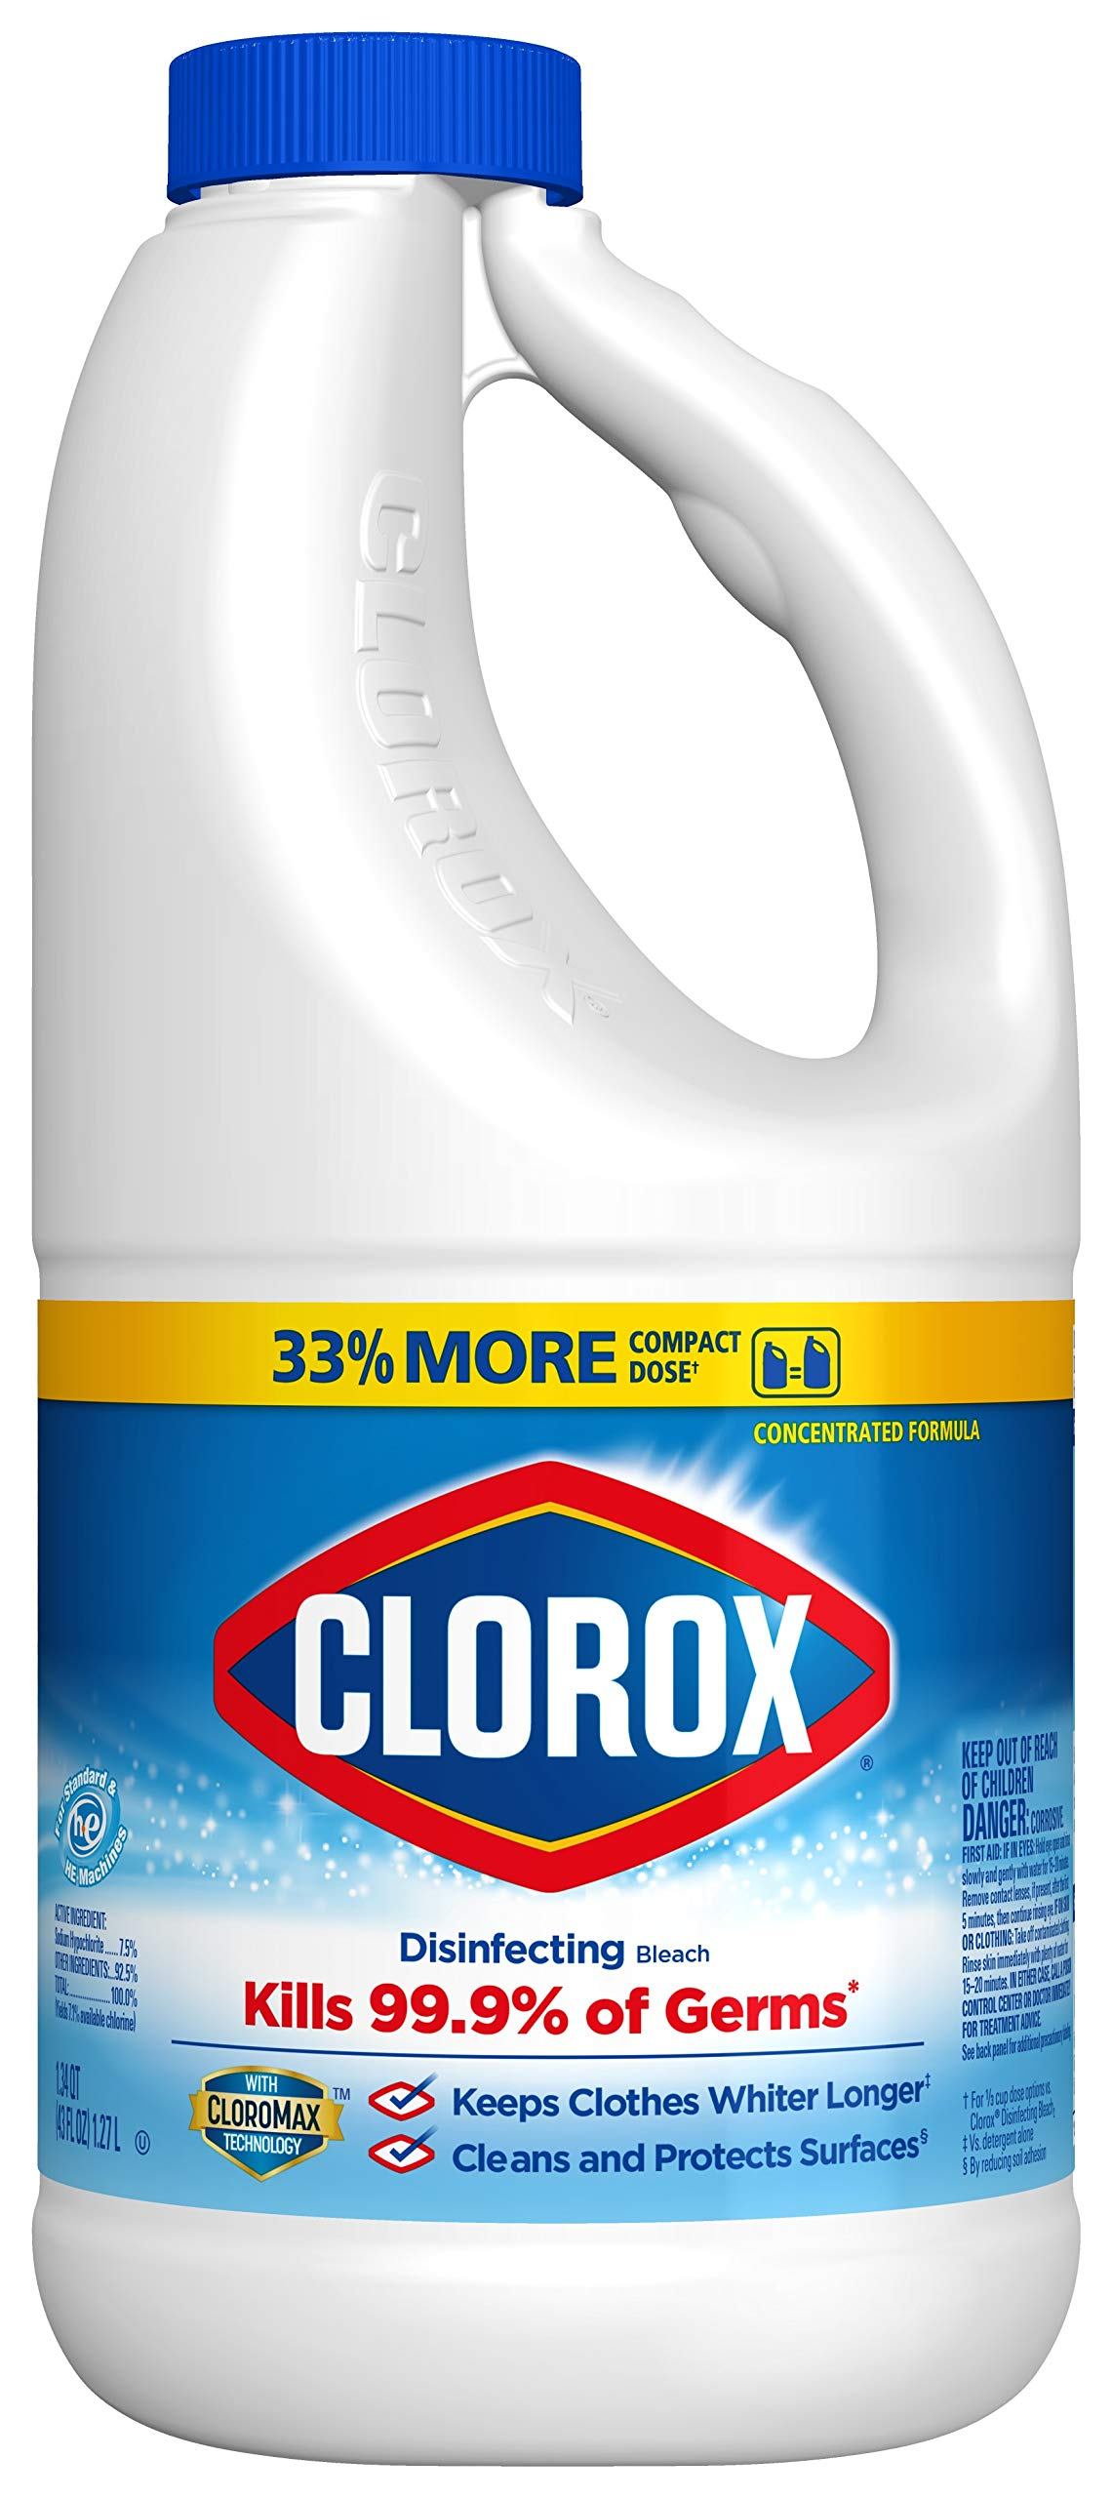
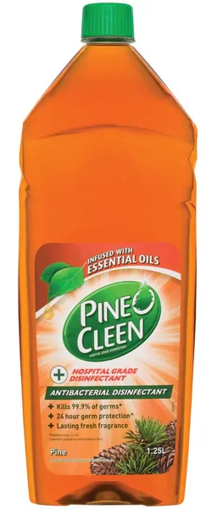
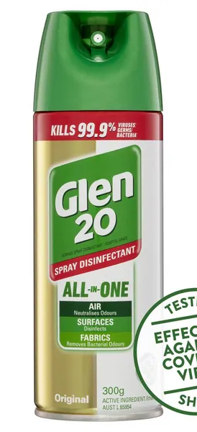
What is a disinfectant?
A disinfectant is a chemical substance or compound used to inactivate or destroy microorganisms on surfaces. These can not be used on or inside the body, as they cause harm to living tissue.
eg bleach, formaldehyde, chlorine

Slide 10


Slide 11
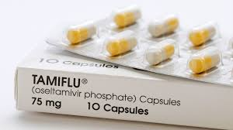
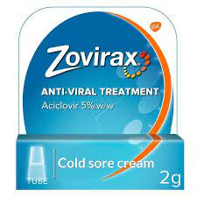
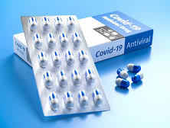
What are antivirals?
Antivirals are medications that help your body fight off certain viruses that can cause disease. Antiviral drugs are also preventive.

Slide 12
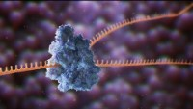

Slide 13
True or false?
You should always finish a course of antibiotics, even if you are feeling better.
There are different medicines for different types of infections.
It is okay to take someone else’s prescription if you have the same illness.
Antibiotics stop you from developing natural immunity.
Antibiotics work for viral infections, like colds and flu.
It is okay to clean surfaces with hand sanitiser.
It is okay to clean your hands with surface cleaner.
You can treat a Covid-19 infection with Clorox and UV.
We need to keep developing new antibiotics because bacteria develop resistance to them (they become less effective).
Superbugs are impossible to kill once they get into your body.

Slide 14
Success criteria
Write a definition for antibiotic, antiseptic, disinfectant and antiviral.
Give an example of an application for each.
Give an example of a compound or medication for each.

